Slide 1
Binary Tree (A)
Prepared by: Afaq Mansoor Khan
BSSE III- Group A
Session 2017-21
IMSciences, Peshawar.

Slide 2
Last Lecture Summary
Introduction to Queue Data Structure
Types of Queue Data Structures
Circular QUEUE and its Operations
Double Ended QUEUE and its operations

Slide 3
Objectives Overview
Introduction to Binary Tree
Operations in Binary tree
Binary Search Tree
Insertion of New Node in BST
Deletion of a Node from BST

Slide 4
Introduction to Tree
Fundamental data storage structures used in programming.
Combines advantages of an ordered array and a linked list.
Searching as fast as in ordered array.
Insertion and deletion as fast as in linked list.

Slide 5

Natural View of a Tree
leaves
branches
root

Slide 6

Computer Scientist’s View
root
leaves
branches
nodes

Slide 7
Parts of a binary tree
A binary tree is composed of zero or more nodes
Each node contains:
A value (some sort of data item)
A reference or pointer to a left child (may be null), and
A reference or pointer to a right child (may be null)
A binary tree may be empty (contain no nodes)
If not empty, a binary tree has a root node
Every node in the binary tree is reachable from the root node by a unique path
A node with neither a left child nor a right child is called a leaf
In some binary trees, only the leaves contain a value

Slide 8
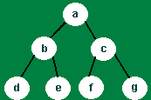
Basic terminology
Finite set of nodes (may be empty -- 0 nodes), which contain data
First node in tree is called the root

Slide 9
Basic terminology
Each node may be linked to 0, 1 or 2 child nodes (or children)
A node with children is a parent; a node with no children is a leaf
Nodes d and e are children of b
Node c is parent of f and g

Slide 10
Size and depth
The size of a binary tree is the number of nodes in it
This tree has size 12
The depth of a node is its distance from the root
a is at depth zero
e is at depth 2
The depth of a binary tree is the depth of its deepest node
This tree has depth 4
a
b
c
d
e
f
g
h
i
j
k
l

Slide 11
Balance
a
a
b
c
b
c
e
d
e
f
g
d
f
h
i
j
g
h
A balanced binary tree
i
j
An unbalanced binary tree
A binary tree is balanced if every level above the lowest is “full” (contains 2^{n} nodes)
In most applications, a reasonably balanced binary tree is desirable

Slide 12
Picture of a binary tree
a
b
c
d
e
f
g
h
i
j
k
l

Slide 13
Binary Search Tree Operations
Creating a Node: We will demonstrate binary tree operations using the IntBinaryTree class.
The basis of our binary tree node is the following struct declaration:
struct TreeNode { int value; TreeNode *left; TreeNode *right; };
The struct is implemented in the class shown next…

Slide 14
IntBinaryTree.h
class IntBinaryTree { public: struct TreeNode { int value; TreeNode *left; TreeNode *right; }; TreeNode *root; void destroySubTree(TreeNode *); void deleteNode(int, TreeNode *&); void makeDeletion(TreeNode *&); void displayInOrder(TreeNode *); void displayPreOrder(TreeNode *); void displayPostOrder(TreeNode *);

Slide 15
IntBinaryTree.h (continued)
public: IntBinaryTree() // Constructor { root = NULL; } ~IntBinaryTree() // Destructor { destroySubTree(root); } void insertNode(int); bool searchNode(int); void remove(int); void showNodesInOrder(void) { displayInOrder(root); } void showNodesPreOrder() { displayPreOrder(root); } void showNodesPostOrder() { displayPostOrder(root); } };

Slide 16
Inserting a Node
Inserting a Node: The idea is to do iterative level order traversal of the given tree using queue. If we find a node whose left child is empty, we make new key as left child of the node. Else if we find a node whose right child is empty, we make new key as right child. We keep traversing the tree until we find a node whose either left or right is empty.

Slide 17
Algorithm
If the root is null:
Replace empty tree with a new tree with the item at the root and return true
else if the item is equal to root.data
The item is already in the tree; return false
else if the item is less than root.data
Recursively insert the item in the left subtree
else
Recursively insert the item in the right subtree

Slide 18
The insertNode Member Function
void IntBinaryTree::insertNode(int num) { TreeNode *newNode, // Pointer to a new node *nodePtr; // Pointer to traverse the tree // Create a new node newNode = new TreeNode; newNode->value = num; newNode->left = newNode->right = NULL; if (!root) // Is the tree empty? root = newNode; else { nodePtr = root;

Slide 19
The insertNode Member Function
while (nodePtr != NULL) { if (num < nodePtr->value) { if (nodePtr->left) nodePtr = nodePtr->left; else { nodePtr->left = newNode; break; } }
else if (num > nodePtr->value) { if (nodePtr->right) nodePtr = nodePtr->right; else { nodePtr->right = newNode; break; } } else { cout << "Duplicate value found in tree.\n"; break; }}}}

Slide 20
Deleting a Node
We simply find its parent and set the child pointer that links to it to NULL, and then free the node's memory.
But what if we want to delete a node that has child nodes? We must delete the node while at the same time preserving the subtrees that the node links to.

Slide 21
Deleting a Node
There are two possible situations when we are deleting a non-leaf node:
A) the node has one child, or
B) the node has two children.

Slide 22
Algorithm
Starting at root, find the deepest and rightmost node in binary tree and node which we want to delete.
Replace the deepest rightmost node’s data with node to be deleted.
Then delete the deepest rightmost node.

Slide 23
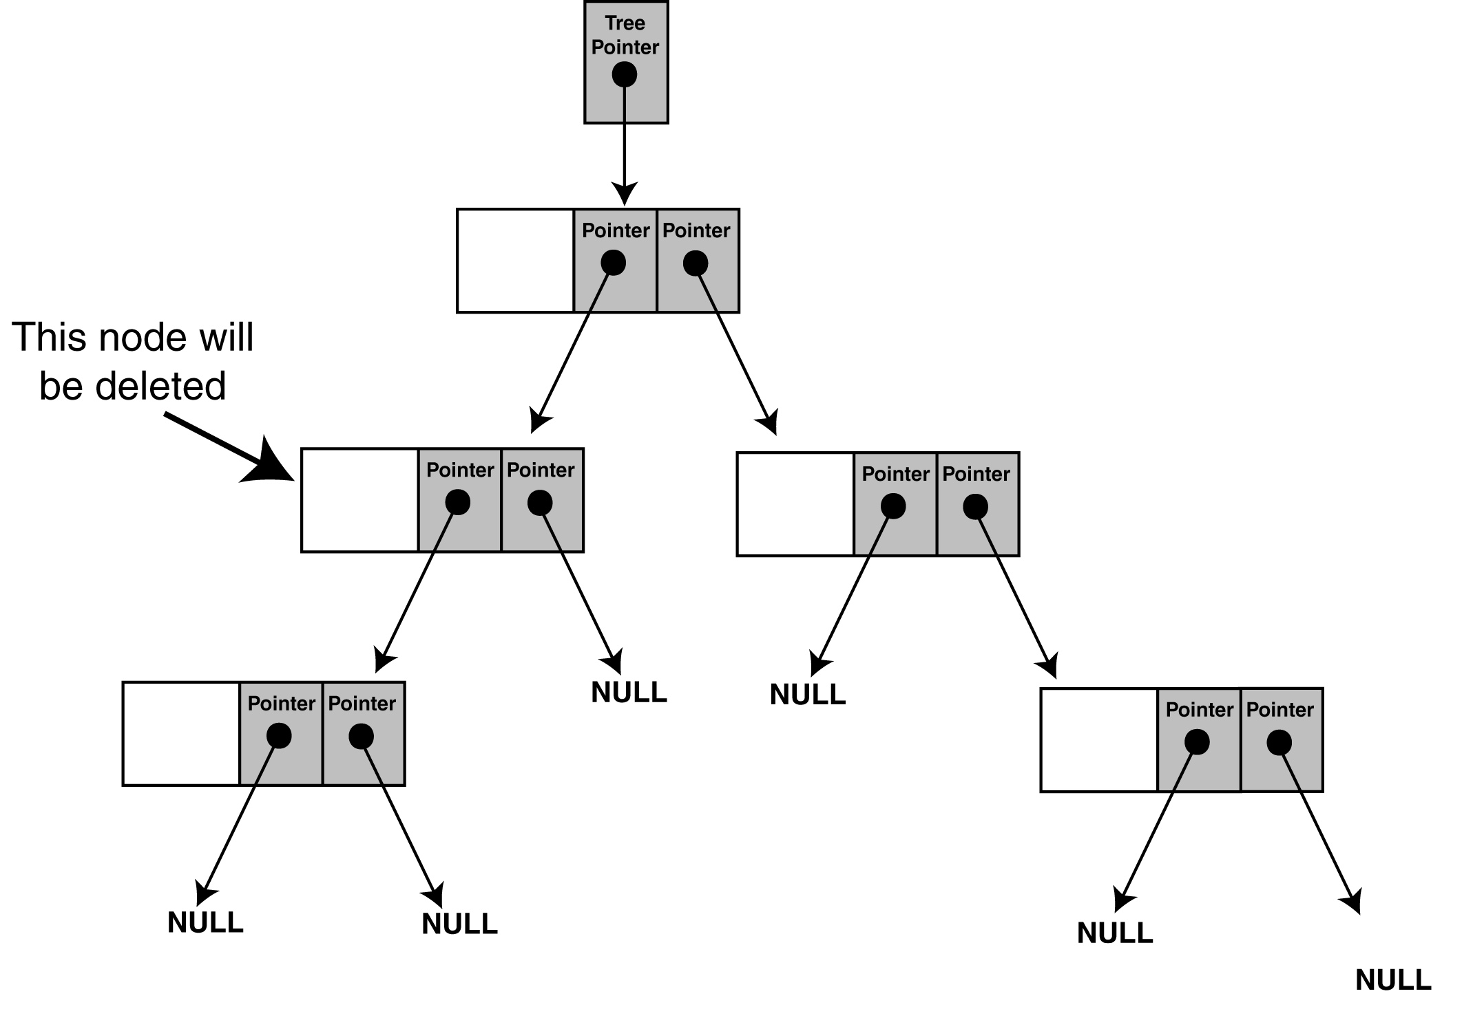
Deleting a Node
Figure illustrates a tree in which we are about to delete a node with one subtree.

Slide 24
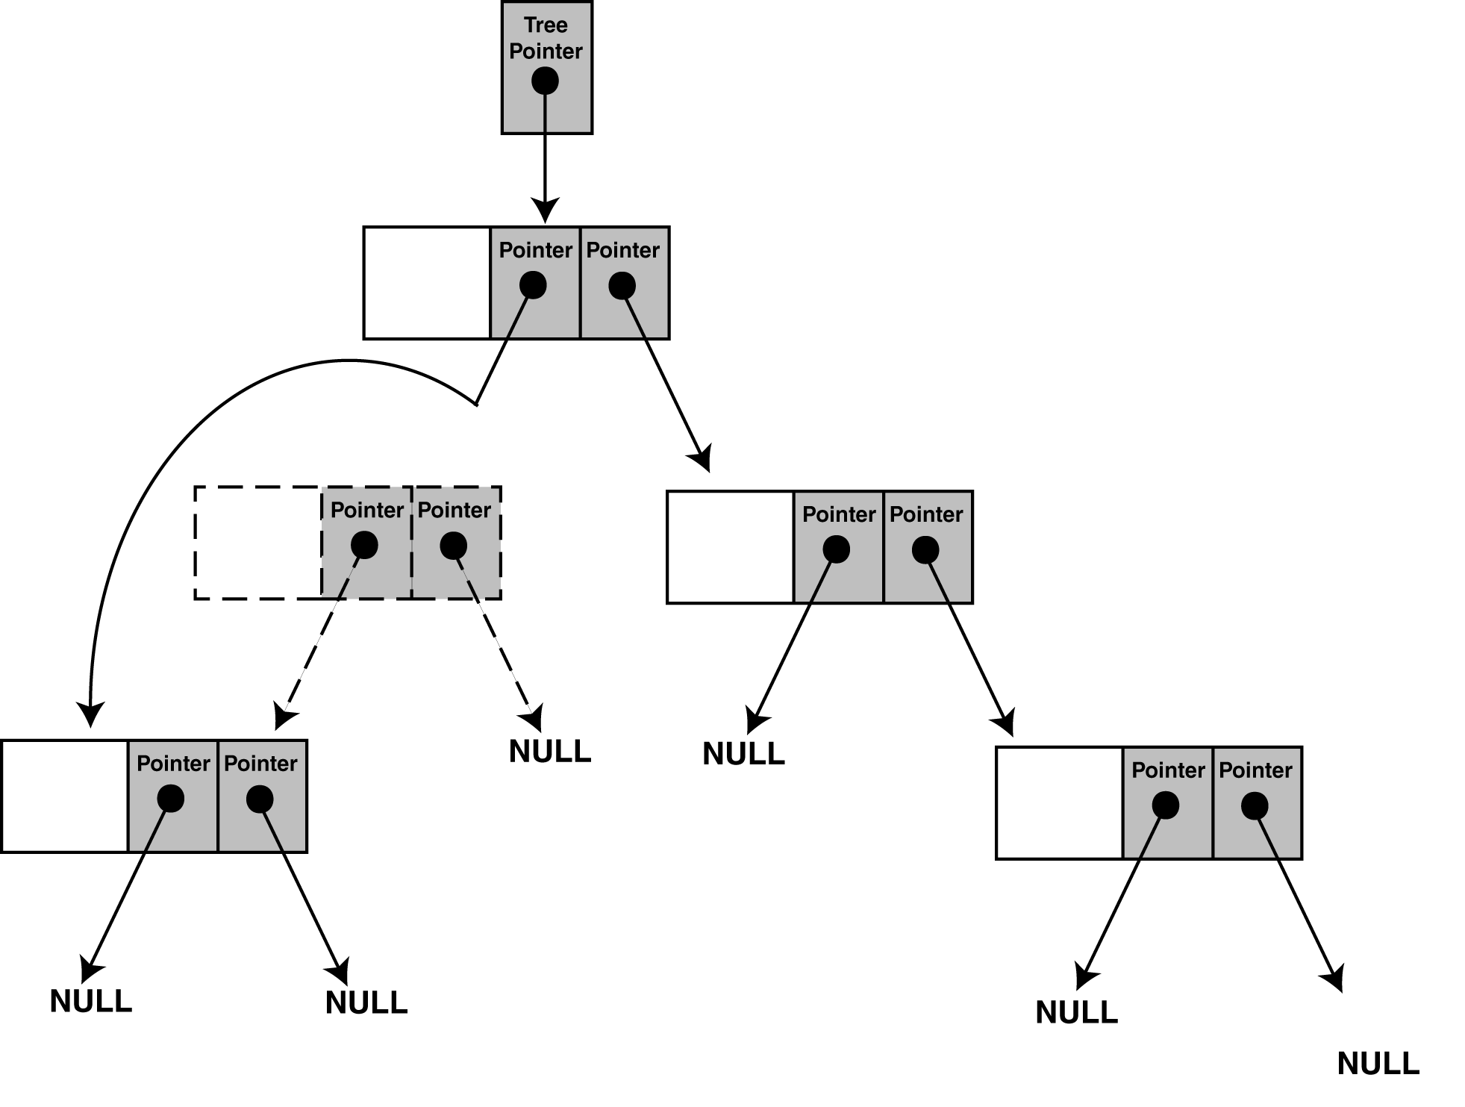
Deleting a Node
Figure shows how we will link the node's subtree with its parent.

Slide 25
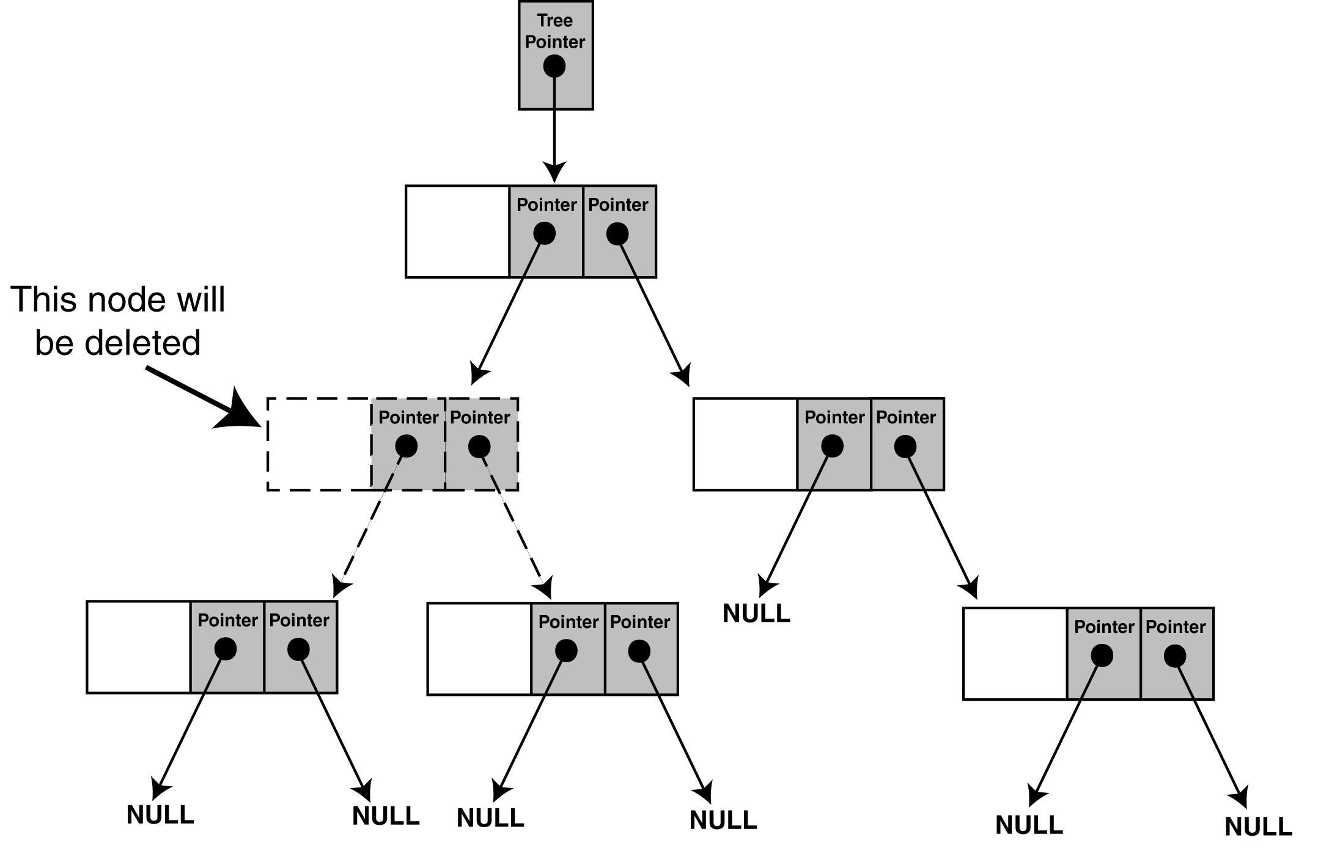
Deleting a Node
The problem is not as easily solved, however, when the node we are about to delete has two subtrees. For example, look at Figure .

Slide 26
Deleting a Node
We cannot attach both of the node's subtrees to its parent, so there must be an alternative solution.
One way is to attach the node's right subtree to the parent, and then find a position in the right subtree to attach the left subtree. The result is shown in Figure.

Slide 27
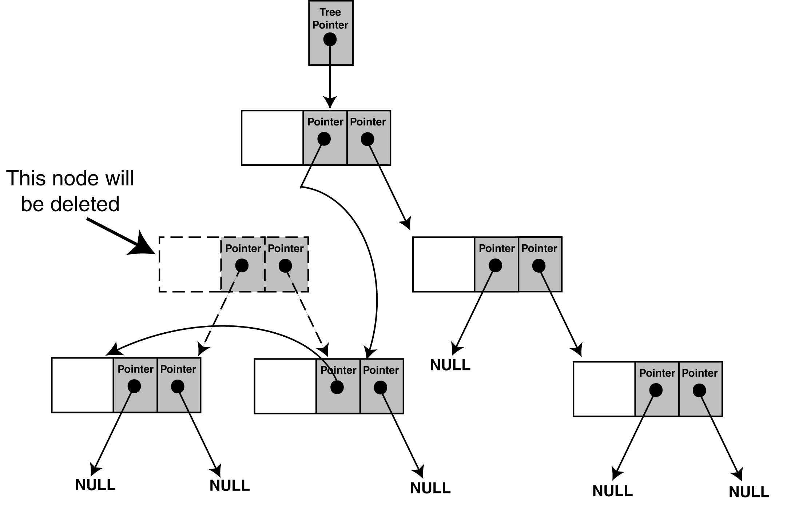
Deleting a Node

Slide 28
Deleting a Node
To delete a node from the IntBinaryTree, call the public member function remove. The argument is the value of the node that is to be deleted.
void IntBinaryTree::remove(int num) { deleteNode(num, root); }
The remove member function calls the deleteNode member function. It passes the value of the node to delete, and the root pointer.

Slide 29
The deleteNode Member Function
void IntBinaryTree::deleteNode(int num, TreeNode *&nodePtr) { if (num < nodePtr->value) deleteNode(num, nodePtr->left); else if (num > nodePtr->value) deleteNode(num, nodePtr->right); else makeDeletion(nodePtr); }
Notice the declaration of the nodePtr parameter:
TreeNode *&nodePtr;
nodePtr is not simply a pointer to a TreeNode structure, but a reference to a pointer to a TreeNode structure. Any action performed on nodePtr is actually performed on the argument passed into nodePtr.

Slide 30
The deleteNode Member Function
else makeDeletion(nodePtr);
The trailing else statement calls the makeDeletion function, passing nodePtr as its argument.
The makeDeletion function actually deletes the node from the tree, and must reattach the deleted node’s subtrees.
Therefore, it must have access to the actual pointer in the binary tree to the node that is being deleted.
This is why the nodePtr parameter in the deleteNode function is a reference.

Slide 31
The makeDeletion Member Function
void IntBinaryTree::makeDeletion(TreeNode *&nodePtr) { TreeNode *tempNodePtr; // Temporary pointer, used in // reattaching the left subtree. if (nodePtr == NULL) cout << "Cannot delete empty node.\n"; else if (nodePtr->right == NULL) { tempNodePtr = nodePtr; nodePtr = nodePtr->left; // Reattach the left child delete tempNodePtr; } else if (nodePtr->left == NULL) { tempNodePtr = nodePtr; nodePtr = nodePtr->right; // Reattach the right child delete tempNodePtr; }

Slide 32
The makeDeletion Member Function
// If the node has two children. else { // Move one node the right. tempNodePtr = nodePtr->right; // Go to the end left node. while (tempNodePtr->left) tempNodePtr = tempNodePtr->left; // Reattach the left subtree. tempNodePtr->left = nodePtr->left; tempNodePtr = nodePtr; // Reattach the right subtree. nodePtr = nodePtr->right; delete tempNodePtr; } }

Slide 33
Summary
Introduction to Binary Tree
Operations in Binary tree
Binary Search Tree
Insertion of New Node in BST
Deletion of a Node from BST
Notes:
A quick summary . . .

Slide 34
References
https://www.geeksforgeeks.org/binary-tree-data-structure/
www2.latech.edu/~box/ds/chap8.ppt
https://www.slideshare.net/vanithachandru/binary-tree-24242122
https://www.cs.cmu.edu/~adamchik/15-121/lectures/Trees/trees.html
https://www.slideshare.net/almario1988/binary-tree-7787268

